Slide 1
Java Programming
Topic 04 – Use-Case Document/Diagram

Slide 2
Object Oriented Development
Phases
Object-Oriented Analysis: understand the domain
Define an object-based model of it
Object-Oriented Design: Define an implementation
Design the solution
Object-Oriented Programming: Build it

Slide 3
Object-Oriented Analysis
examines requirements from the perspective of the classes and objects found in the vocabulary of the problem domain
Steps in examining requirements are:
Use Case Document preparation
Object Model preparation

Slide 4
What is Use-case?
Narrative description of a goal-oriented interaction between the system under development and an external agent
A dialog script written for two actors - captures requirements in the form of interactions with an end user
A use case is a list of actions or event steps, typically defining the interactions between a role and a system, to achieve a goal
How to identify a use-case? - Functional requirements – Goals of an actor

Slide 5
Use-case History
Pioneered by Ivar Jacobson in 1995 - an important component in his Objectory methodology and its simplified OOSE
DOES NOT REQUIRE TECHNICAL KNOWLEDGE

Slide 6
Use Case Document

Slide 7
Main Sections of Use-case Document
Use Case Name
Description
Actors
Trigger
Preconditions
Flow – Basic Flow, Alternates and Exceptions
Level
Post condition
Stakeholders

Slide 8
Naming a use-case
Create Unique and Explanatory Names
Done based on an organization’s data standards
Needs to be searchable and easily available when needed

Slide 9
Actors
The people or elements who are involved in the process.
Primary Actor
person who is responsible for the event for which the Use Case exists
Secondary Actor
person or group of people who are needed to complete the process successfully

Slide 10
Trigger
The exact action which results in the Use Case
Types of Trigger:
External - started by an actor, either a person or another system requesting information
An airline reservation system requesting flight information from an airline system.
Temporal - triggered or started by time. Events occur at a specific time.
Sending an email about special offers once a week on a Sunday evening

Slide 11
Precondition
Conditions that need to be met to ensure that the use case can be fulfilled.
If these conditions are not met, then the case cannot run its course.

Slide 12
Flow
Depicts
How will the communication flow?
To Whom will be the information displayed to?
What do they need to do?
Where will the primary actor end up?
3 things to mention when writing the flow: -
Basic Flow - best case scenario of what should happen in the use case if all the conditions are met.
Alternates: Are there any alternate routes that the action can be done?
Exceptions: What happens when a failure occurs in the flow.
Exceptions are just as important to define as basic flow.

Slide 13
Level
Explains the urgency which it needs to be dealt with.
Needs to ensure that whoever reads the use case realizes its importance to ensure that they give it the right amount of time.
Different levels of use-case:
High Level Summary(white/cloud) -Enterprise level
Summary of goals (Kite) - business unit or department level
User Goal (Blue/ Sea level) - usually written for a business activity and each person should be able to do one blue level activity in anywhere from 2 to 20 minutes.
Sub-Function (Indigo/ fish) - shows lots of detail
Low Level (Black/calm) - most detailed use cases

Slide 14
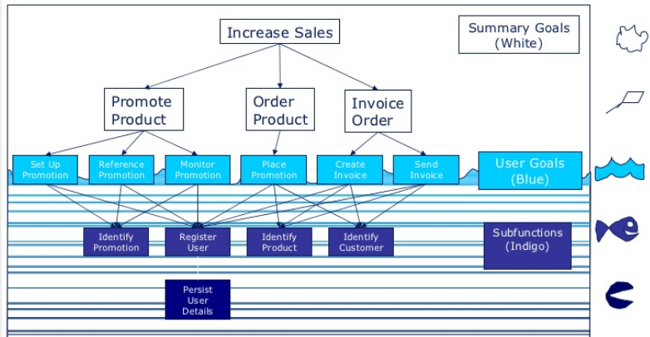
Level - Example

Slide 15
Postcondition
State of the system after the use case has finished
output people have received
transmissions to other systems
data that have been created or updated

Slide 16
Stakeholders
Who are the people that are going to be affected by the use case?
Only when you know all the people involved, will you be able to ensure that your design does everything that it needs to do.

Slide 17
Things to remember
Reminder 1. A use case is a prose essay
Reminder 2. Make the use case easy to read (active voice).
Reminder 3. Just one sentence form
Reminder 4. Include sub use cases
Reminder 5. Keep the GUI out
Reminder 6. Mandatory two endings

Slide 18
Use Case Document - Examples

Slide 19
Example-1 Coin Flip
Use Case Name: Coin Flip
Description: A player at random offers a prediction of coin flip. The other play gets the other option. The coin is flipped. The correct guess wins
Actors:
A player who makes the prediction
A player who gets the other option
Coin
Coin game

Slide 20
Example-1 Coin Flip
Trigger: A player at random offers a prediction.
Preconditions:
2 players are available
A coin available
Basic Flow ("Sunny Day Scenario"):
A player at random is picked to predict the coin flip.
A player picked offers the prediction for the coin flip.
The coin is flipped and the result is provided.
A winner and loser is picked.
Offer to try it again.

Slide 21
Example-1 Coin Flip
Alternates: no
Exceptions: no failure condition.
Post conditions: one player wins and other loses
Stakeholders: Nil

Slide 22
Example-2: Car Rental Application
Use Case Name: Release a Vehicle (to a Customer)
Description: A customer arrives to acquire the vehicle and depart for desired destination. The vehicle reservation contract is signed and the vehicle is released to the customer.
Actors: Front-Desk Clerk, Customer
Preconditions: Vehicle has been assigned to the customer

Slide 23
Example-2: Car Rental Application
Basic Flow:
A customer comes to the office to acquire a vehicle.
The clerk locates the vehicle reservation contract by means of the reservation number and/or customer name. [Exception: Required vehicle type is not available due to late arrivals.]
The customer signs the contract and the clerk gives the keys to the vehicle.
The clerk then marks the contract active by entering the vehicle release date (today's date) onto the vehicle reservation contract. The use case terminates at this point.

Slide 24
Example-2: Car Rental Application
Exceptions:
Required vehicle type is not available due to late arrivals:
The customer is informed of the situation and told about the other vehicle types that are available.
The customer is offered an incentive to accept another vehicle type.
If the customer is not satisfied, the reservation is cancelled without penalty charges.
The customer either accepts another vehicle type or cancels the reservation.
Postconditions: The customer departs with the vehicle and the reservation contract is marked active, or the reservation is cancelled.

Slide 25
Example-3: Online Support Request
Use Case Name : Support Request
Description: A person generates a support request on a website for electronic products.
Actors
Person who generates support request by clicking button
Customer Support Representative

Slide 26
Example-3: Online Support Request
Preconditions:
The person who generates the request needs to have an active internet connection
The website needs to be accessible by the customer
The support agent needs to have an active internet connection

Slide 27
Example-3: Online Support Request
Basic Flow
The customer visits the support website
The customer clicks the “generate support ticket button”
The customer is taken to a page where they are told that support will be present shortly.
The ticket is sent to the support department
A customer support representative takes hold of the ticket
The customer support representative is sent to the same page as the user where there is a chat box
The customer support representative provides the help and support to the customer
The customer closes the chat window
The customer support representative closes the support ticket and enters information about the session.
The use case ends

Slide 28
Example-3: Online Support Request
Alternates:
The customer asks to be contacted over the phone
The customer might request someone come to their home to help them with the product
Exception:
The customer loses their internet connection between the chat. They are then shown an error message.
The customer service representative accidentally closes the chat window, ending the support session. The customer is informed that another representative will be with them shortly.

Slide 29
Example-3: Online Support Request
Level:
Customer complaints
General Feedback
Trigger : customer clicks the button on the website to generate a support ticket
Stakeholders:
The Customer Support Department – The whole department’s purpose is to ensure customer satisfaction.
The Sales Department – If the customer is unable to get their problem fixed they might want to return the product, which will be a loss for the sales department.

Slide 30
Use Case Diagram

Slide 31
Use-case Diagram
Shows the relationship between the user and the different use cases in which the user is involved.
Purposes
Gather the requirements of a system.
Get an outside view of a system.
Identify the external and internal factors influencing the system.
Show the interaction among the requirements are actors.

Slide 32
Use-Case Diagrams – How to draw?
When we are planning to draw a use case diagram, we should have the following items identified.
Functionalities to be represented as use case
Actors
Relationships among the use cases and actors.

Slide 33
Use-Case Diagrams – How to draw?
Guidelines to draw an efficient use case diagram:-
The name of a use case is very important. The name should be chosen in such a way so that it can identify the functionalities performed.
Give a suitable name for actors.
Show relationships and dependencies clearly in the diagram.
Do not try to include all types of relationships, as the main purpose of the diagram is to identify the requirements.
Use notes whenever required to clarify some important points.

Slide 34
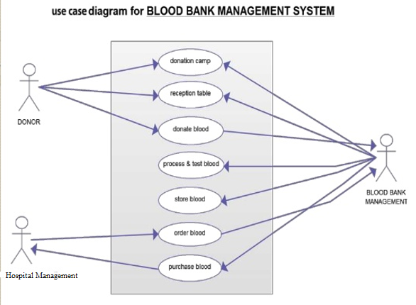
Blood Bank Management System

Slide 35
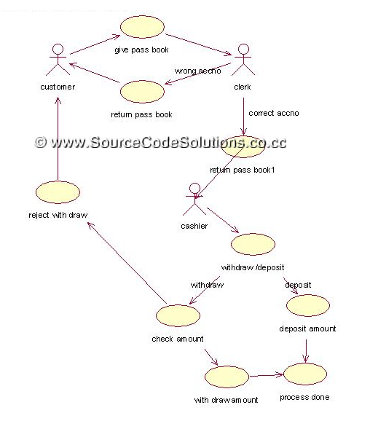
Bank Transaction System

Slide 36
Thank you

